Slide 1
Lesson 1
Steps In Performing A Significance Test

Slide 2
Lesson Contents
Steps in significance testing
Interpreting the p-value

Slide 3
Significance Testing
Also called “Hypothesis Testing”.
Uses probability to provide a way to quantify how plausible a parameter is while controlling the chance of an incorrect inference.
Method for using data to summarize the evidence about a hypothesis.
Determine whether there is enough evidence in favor of certain belief, or hypothesis, about a parameter.

Slide 4
Significance Testing
Questions about the parameter.
Is there statistical evidence, from a random sample of potential customers, to support the hypothesis that more than 10% of the potential customers will purchase a new product when seen in Facebook?
Is a new drug effective in curing a certain disease? A sample of patients is randomly selected. Half of them are given the drug while the other half are given a placebo. The conditions of the patients are then measured and compared.

Slide 5
Steps in Conducting a Significance Test
Assumptions
State the hypotheses
Compute for the Test Statistic
Interpret the P-value
Make a conclusion

Slide 6
Step 1
Assumptions

Slide 7
Assumptions
Each significance test makes certain assumptions or has certain conditions under which it applies.
Assumptions may be about the sample size or about the shape of the population distribution.

Slide 8
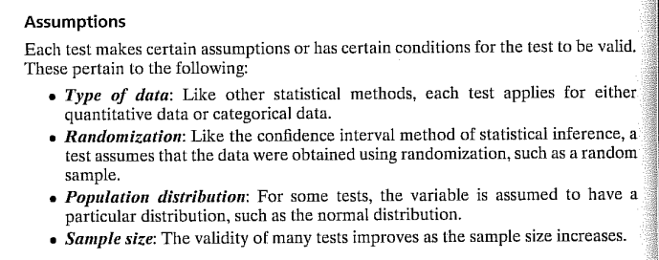
Assumptions

Slide 9
Step 2
Hypotheses

Slide 10
Formulation of Hypotheses
A hypothesis is a statement about a population, usually claiming that a parameter takes a particular numerical value or falls in a certain range of values.
For a categorical variable the parameter is a proportion, ρ
For a quantitative variable the parameter is a mean, μ
The two types of hypothesis:
Null
Alternative

Slide 11
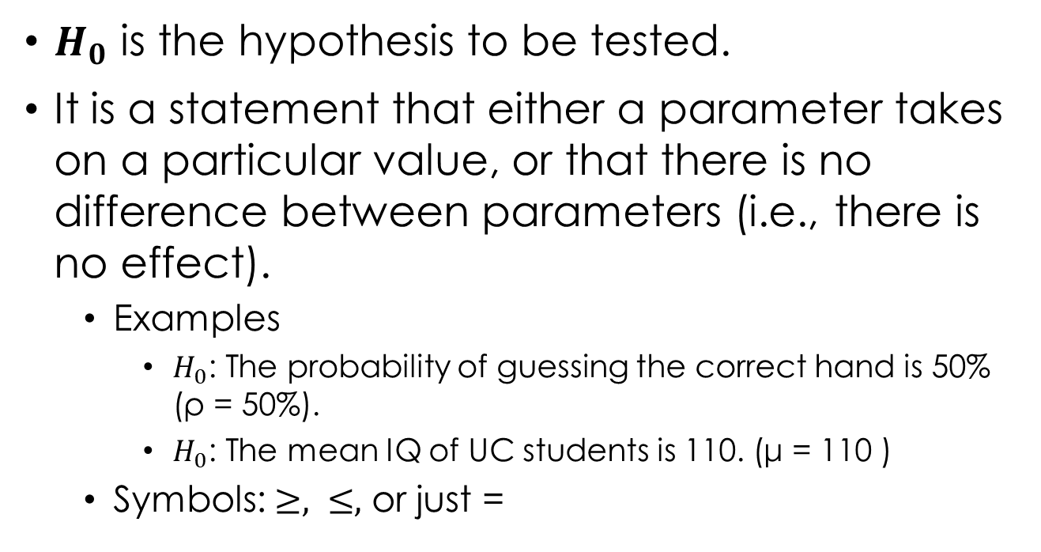
Null Hypothesis
$H_{0}$ is the hypothesis to be tested.
It is a statement that either a parameter takes on a particular value, or that there is no difference between parameters (i.e., there is no effect).
Examples
$H_{0}$: The probability of guessing the correct hand is 50% (ρ = 50%).
$H_{0}$: The mean IQ of UC students is 110. (μ = 110 )
Symbols: $≥, ≤,$ or just =

Slide 12
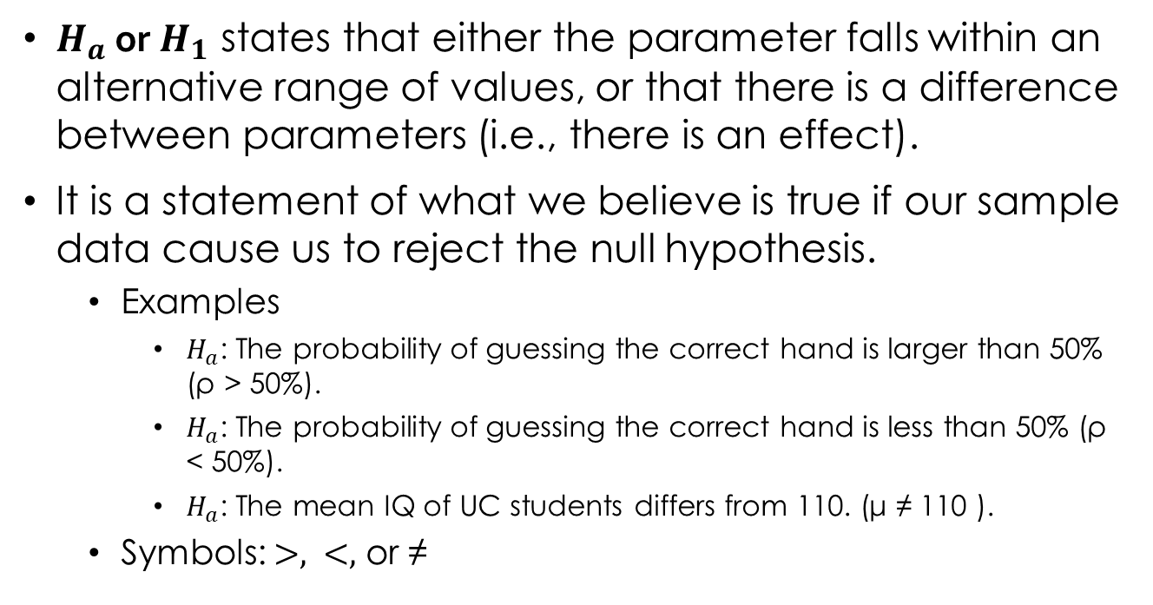
Alternative Hypothesis
$H_{a}$ or $H_{1}$ states that either the parameter falls within an alternative range of values, or that there is a difference between parameters (i.e., there is an effect).
It is a statement of what we believe is true if our sample data cause us to reject the null hypothesis.
Examples
$H_{a}$: The probability of guessing the correct hand is larger than 50% (ρ > 50%).
$H_{a}$: The probability of guessing the correct hand is less than 50% (ρ < 50%).
$H_{a}$: The mean IQ of UC students differs from 110. (μ ≠ 110 ).
Symbols: $>, <,$ or ≠

Slide 13


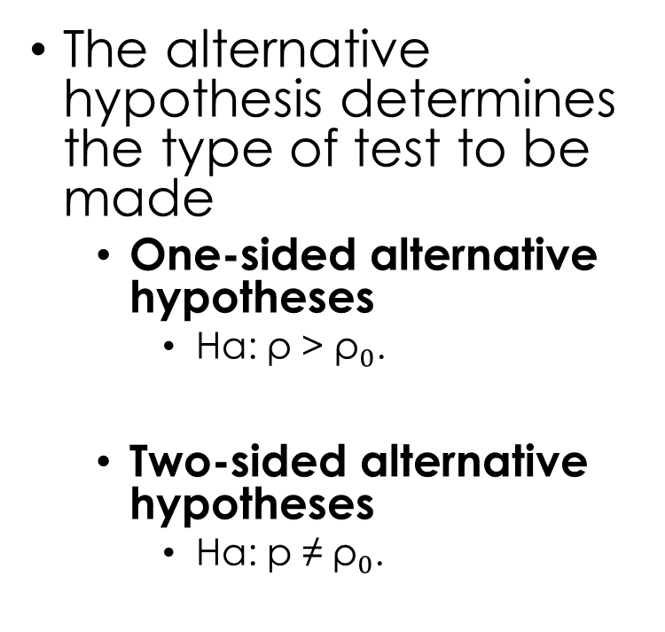
Type of Test
The alternative hypothesis determines the type of test to be made
One-sided alternative hypotheses
Ha: ρ > ${\text{ρ}}_{0}$.
Two-sided alternative hypotheses
Ha: p ≠ ${\text{ρ}}_{0}$.

Slide 14
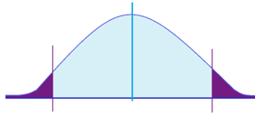
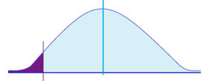
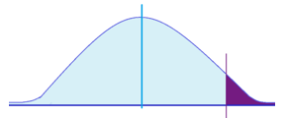

Type of Test
Two – tailed test ($H_{a}: ≠)$
One – tailed test
Left – tailed test ($H_{a}:<)$
Right – tailed test ($H_{a}:>)$

Slide 15
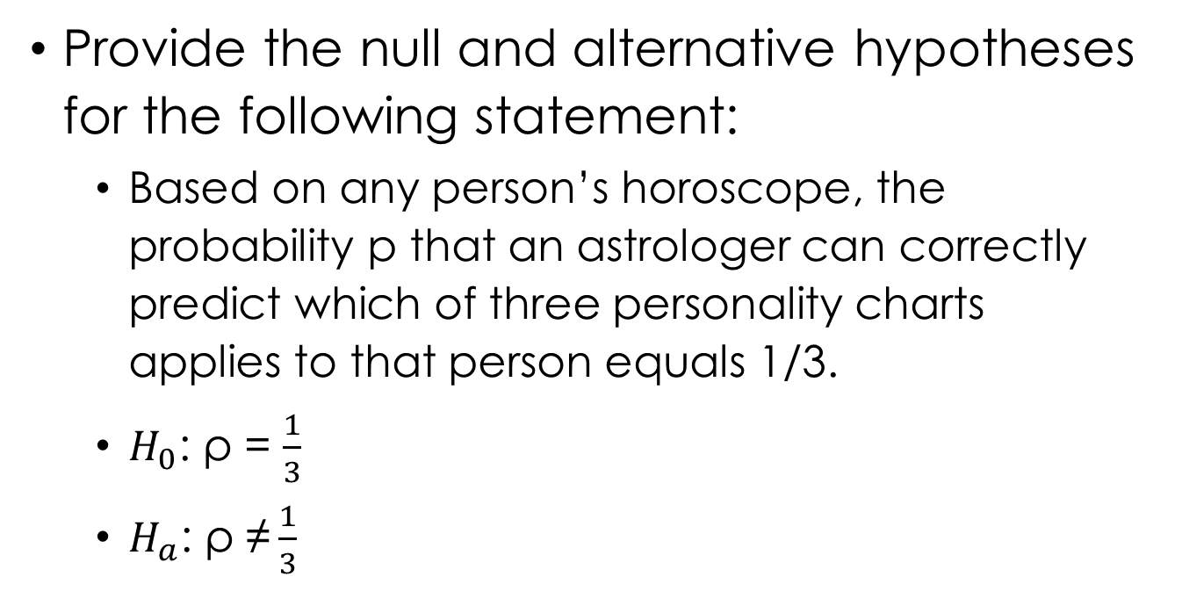
Example
Provide the null and alternative hypotheses for the following statement:
Based on any person’s horoscope, the probability p that an astrologer can correctly predict which of three personality charts applies to that person equals 1/3.
$H_{0}$: ρ = $\frac{1}{3}$
$H_{a}$: ρ ≠ $\frac{1}{3}$

Slide 16
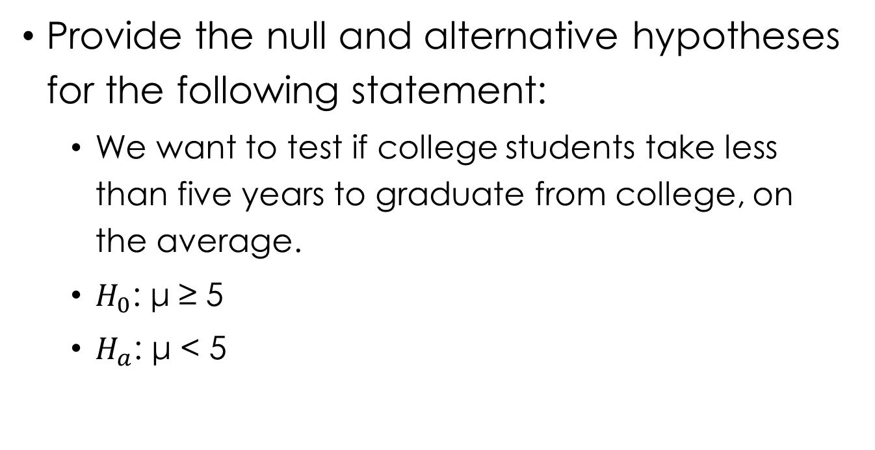
Example
Provide the null and alternative hypotheses for the following statement:
We want to test if college students take less than five years to graduate from college, on the average.
$H_{0}$: μ ≥ 5
$H_{a}$: μ < 5

Slide 17
Example
Identify whether the following statements are null or alternative hypotheses:
In Canada, the proportion of adults who favor legalized gambling is 0.50.
The proportion of all Canadian college students who are regular smokers is less than 0.24, the value it was 10 years ago.
The mean IQ of all students at UC is larger than 100.
The mean working hours for the working population differs from 40 hours.

Slide 18
Step 3
Compute the test statistic

Slide 19
Test Statistic
A test statistic describes how far that point estimate falls from the parameter value given in the null hypothesis.
It shows how closely the observed data match the distribution expected under the null hypothesis of that statistical test.

Slide 20
Interpreting the test statistic
A test statistic describes how far that point estimate falls from the parameter value given in the null hypothesis.
It shows how closely the observed data match the distribution expected under the null hypothesis of that statistical test.

Slide 21
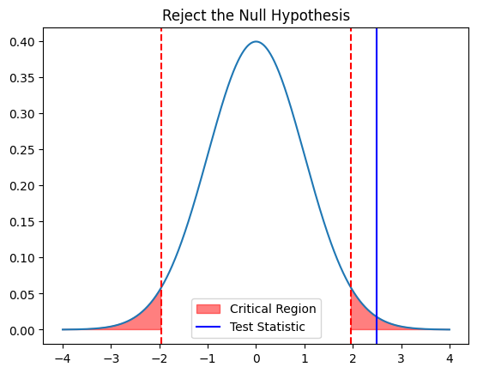
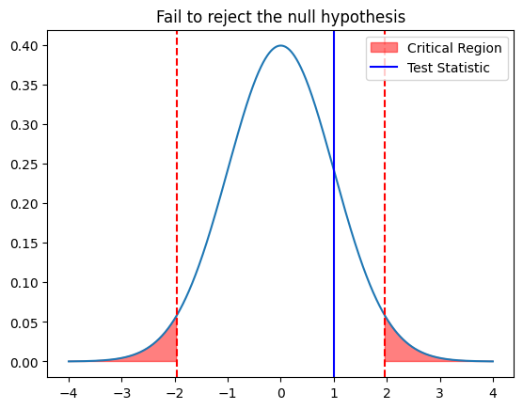
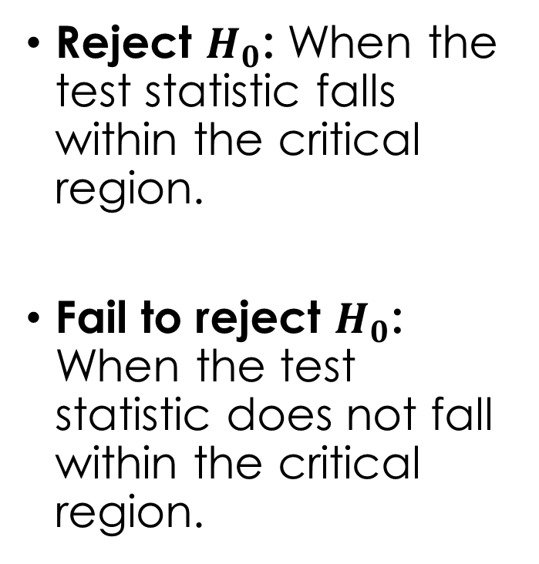
Interpreting the test statistic
Reject $H_{0}$: When the test statistic falls within the critical region.
Fail to reject $H_{0}$: When the test statistic does not fall within the critical region.

Slide 22
Step 4
Interpret the p-value

Slide 23
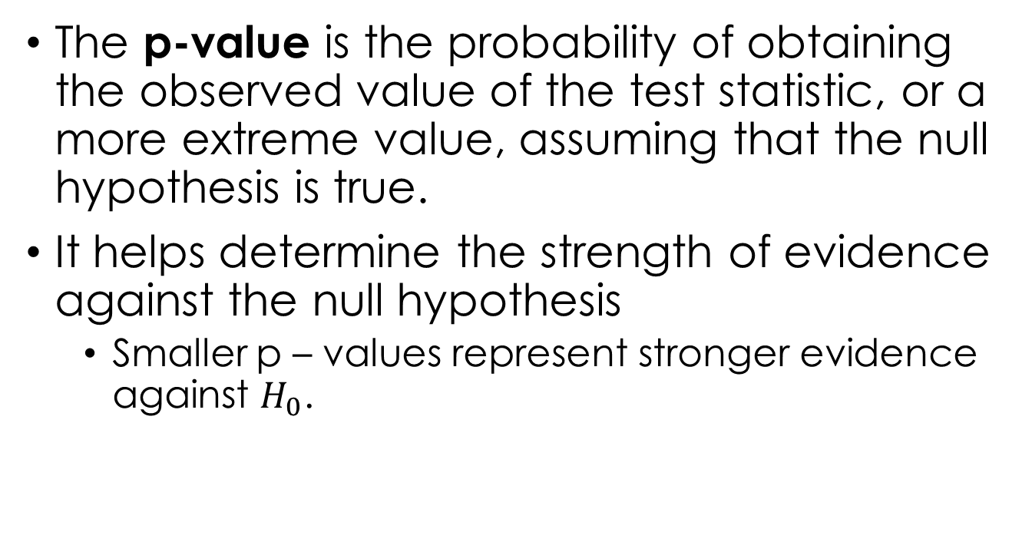
P-value
The p-value is the probability of obtaining the observed value of the test statistic, or a more extreme value, assuming that the null hypothesis is true.
It helps determine the strength of evidence against the null hypothesis
Smaller p – values represent stronger evidence against $H_{0}$.

Slide 24
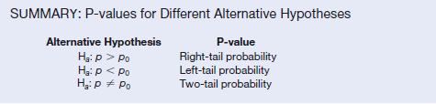
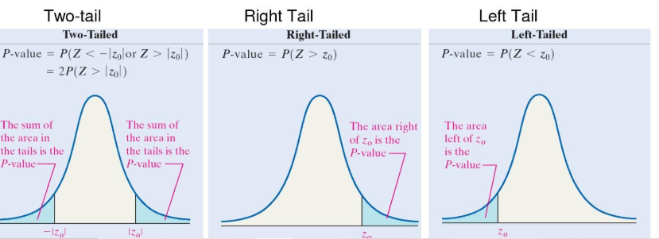
Visualizing the p-value

Slide 25
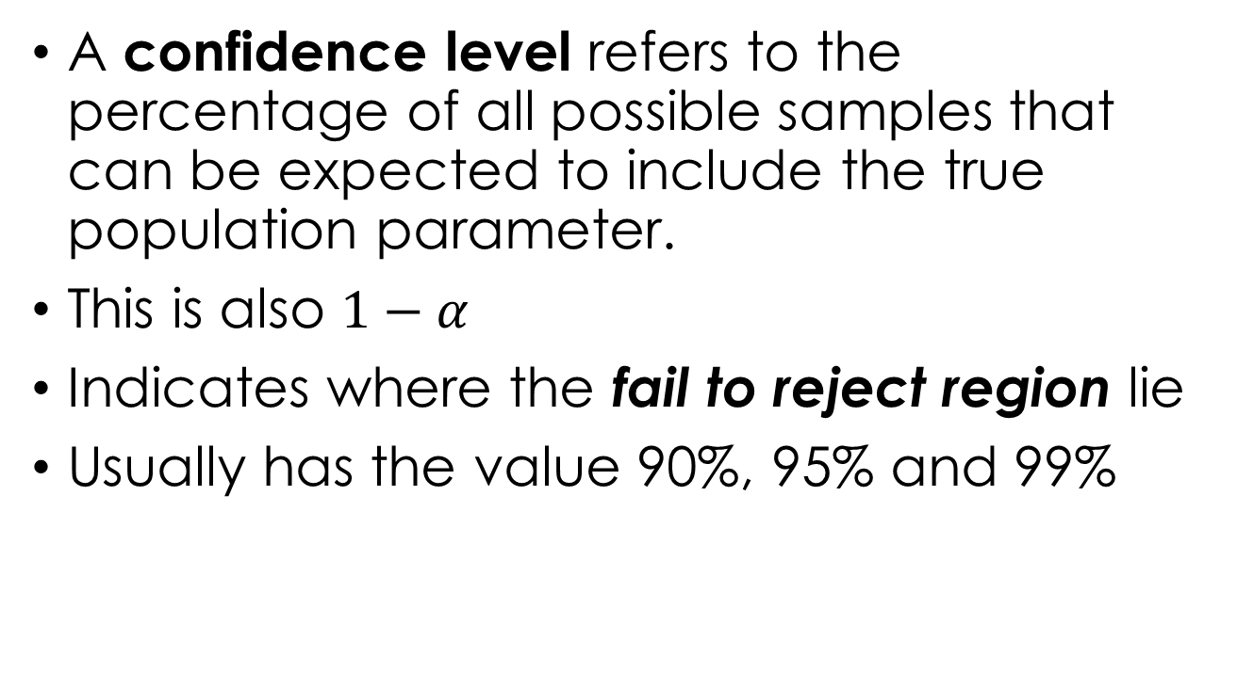

Confidence Level and Significance Level ($α$)
A confidence level refers to the percentage of all possible samples that can be expected to include the true population parameter.
This is also $1−α$
Indicates where the fail to reject region lie
Usually has the value 90%, 95% and 99%

Slide 26
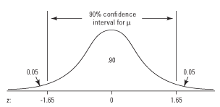

Confidence Level and Significance Level ($α$)
Confidence Level: 90%
Significance Level: $α=0.1$
Critical z – scores: - 1.645 and 1.645

Slide 27
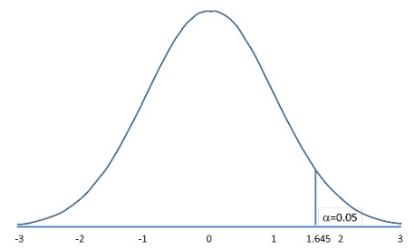

Confidence Level and Significance Level ($α$)
Confidence Level: 95%
Significance Level: $α=0.05$
Critical z – score: 1.645

Slide 28
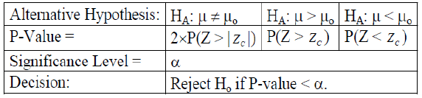
Calculating the p-value
Calculating p-value depends on the alternative hypothesis, H_{A}.
Suppose, we compute z-statistic, z_{c}, we compute the p-value using the following:

Slide 29

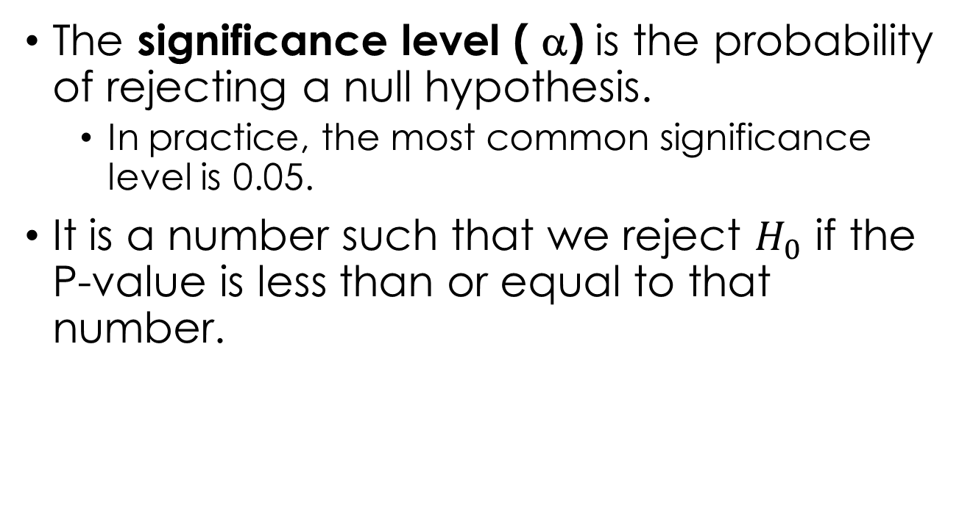
Interpreting the p-value
The significance level ( α) is the probability of rejecting a null hypothesis.
In practice, the most common significance level is 0.05.
It is a number such that we reject $H_{0}$ if the P-value is less than or equal to that number.

Slide 30
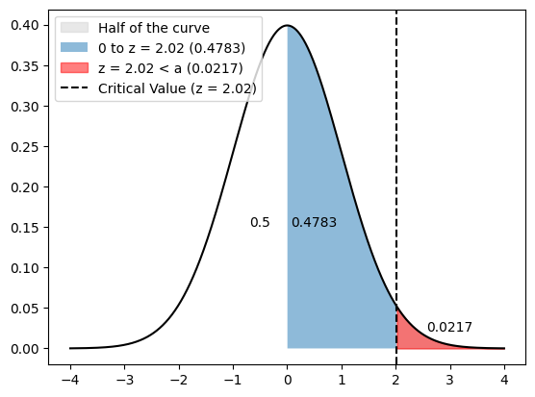
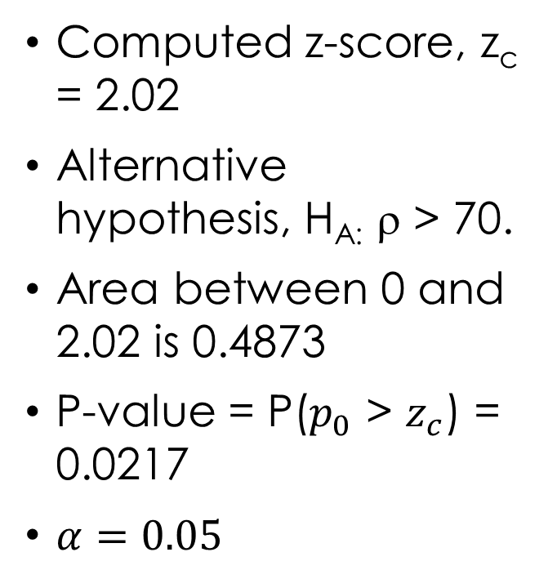
Calculating the p-value: Example 1
Computed z-score, z_{c} = 2.02
Alternative hypothesis, H_{A:} ρ > 70.
Area between 0 and 2.02 is 0.4873
P-value = P($p_{0}$ > $z_{c}$) = 0.0217
$α=0.05$

Slide 31
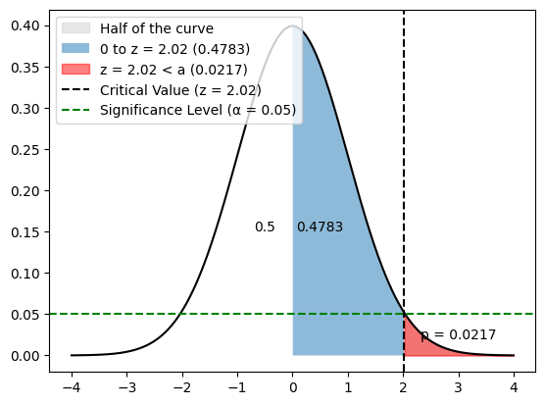
Interpreting the p-value: Example 1
Decision:
Since p-value < α, that is, 0.0217 < 0.05, we reject the null hypothesis and thus, accept the alternative hypothesis.

Slide 32
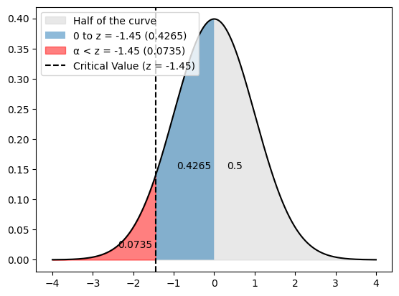
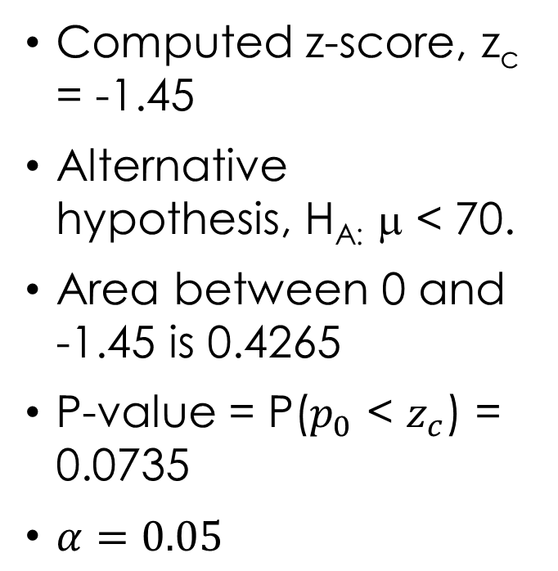
Calculating the p-value: Example 2
Computed z-score, z_{c} = -1.45
Alternative hypothesis, H_{A:} μ < 70.
Area between 0 and -1.45 is 0.4265
P-value = P($p_{0}$ < $z_{c}$) = 0.0735
$α=0.05$

Slide 33
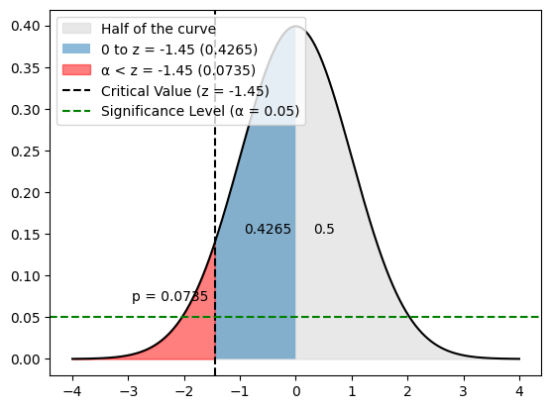
Interpreting the p-value: Example 2
Decision:
Since p-value > α, that is, 0.0735 > 0.05, we fail to reject the null hypothesis, in other words, accept the null hypothesis.

Slide 34
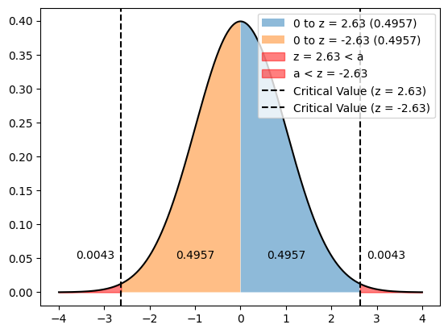
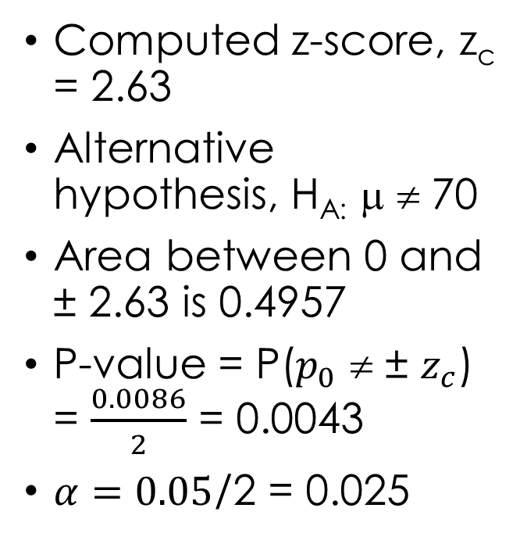
Calculating the p-value: Example 3
Computed z-score, z_{c} = 2.63
Alternative hypothesis, H_{A:} μ ≠ 70
Area between 0 and ± 2.63 is 0.4957
P-value = P($p_{0}$ ≠ ± $z_{c}$) = $\frac{0.0086}{2}$ = 0.0043
$α=0.05$/2 = 0.025

Slide 35
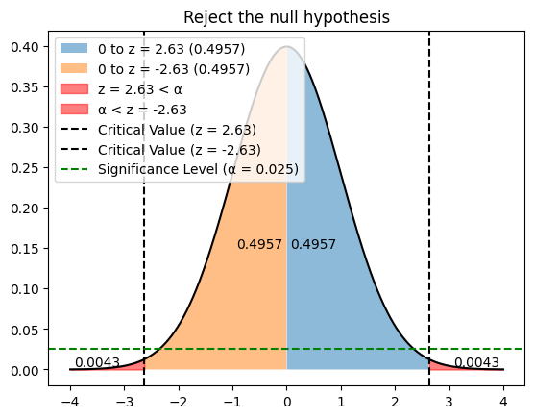
Interpreting the p-value: Example 3
Decision:
Since p-value < α, that is, 0.0043 < 0.05, we reject the null hypothesis, in other words, accept the null hypothesis.

Slide 36
Step 5
Make a conclusion

Slide 37
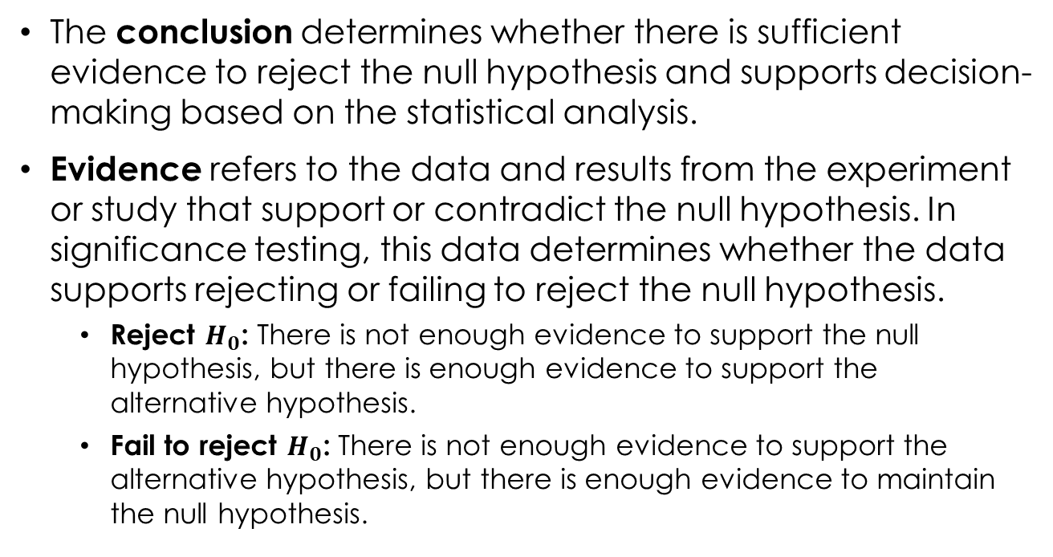
Conclusion
The conclusion determines whether there is sufficient evidence to reject the null hypothesis and supports decision-making based on the statistical analysis.
Evidence refers to the data and results from the experiment or study that support or contradict the null hypothesis. In significance testing, this data determines whether the data supports rejecting or failing to reject the null hypothesis.
Reject $H_{0}$: There is not enough evidence to support the null hypothesis, but there is enough evidence to support the alternative hypothesis.
Fail to reject $H_{0}$: There is not enough evidence to support the alternative hypothesis, but there is enough evidence to maintain the null hypothesis.

Slide 38
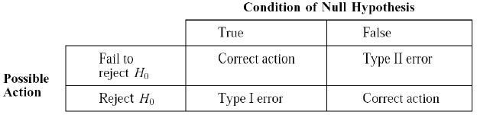
Null Hypothesis Cases
True Positive (Correct Rejection): This occurs when we reject the null hypothesis when it is actually false. It's the correct decision.
False Positive (Type I Error): This occurs when we reject the null hypothesis when it is actually true. It's an incorrect decision, also known as a Type I error.
False Negative (Type II Error): This occurs when we fail to reject the null hypothesis when it is actually false. It's an incorrect decision, also known as a Type II error.
True Negative (Correct Non-rejection): This occurs when we fail to reject the null hypothesis when it is actually true. It's the correct decision.

Slide 39
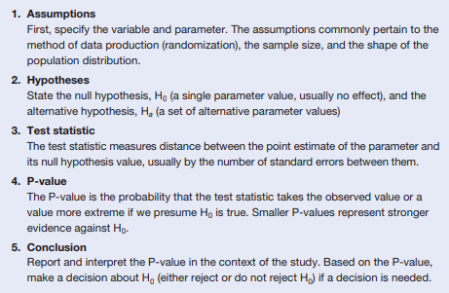
In summary…

Slide 40
END

